Slide 1
IANR Staff Performance Management and Merit Process
September 2023
Notes:
Today we will be talking about the IANR Staff Performance Management and Merit Process

Slide 2
Performance Management and Merit
Responsibility of IANR HR Office
Performance Management (Performance Conversations)
Responsibility of IANR Budget Office
Annual Merit Increases
Notes:
It is important to recognize that performance management and annual merit increases are two separate and distinct processes.
IANR’s Staff Performance Management process is the responsibility of the IANR HR Office. IANR HR establishes performance management processes and can provide support with performance conversations as well as the Trakstar Perform system.
The Annual Merit Increase process is the responsibility of the IANR Budget Office. The IANR Budget Office distributes the annual budget guidelines and provides support with the annual merit process and budget module.

Slide 3
Performance Management
Notes:
We will start by providing a quick overview of the staff performance management process.

Slide 4
IANR Performance Management Process
Steps:
6 questions
Employee & manager prep for conversation
2 twice per year
Conversation takes place
Employee summarizes conversation online in Trakstar Perfom
Employees should come away from the conversations with a clear understanding of expectations and if they are fulfilling expectations.
Manager reviews & finalizes
Notes:
Employees and supervisors are asked to document two performance conversations per year. The conversation windows are September 15 – November 15 and January 15 – March 15.
The intent of the conversations is to encourage frequent discussions between supervisors and employees, focusing on staff growth and development.
The process is flexible and employee-driven. It is strengths-based and encourages discussion around upcoming priorities to ensure alignment with supervisor’s expectations.
These conversations should be honest and robust so that employees come away from the conversations with a clear understanding of their performance in relation to mutually agreed-upon expectations.

Slide 5
Performance Conversation Timing
Fall
Spring
Annual Merit Process
Performance Conversation
September 15 – November 15
Performance Conversation
January 15 – March 15
March - June
Performance Conversations will inform the annual merit increase decisions
Driven by IANR HR
Driven by IANR HR
Driven by IANR Budget Office
Notes:
Performance conversations occur two times during the year. Once in the Fall and again in the Spring. Again, this part of the process is managed by the IANR HR Office.
The Fall window will be open from September 15 – November 15 and the Spring from January 15 – March 15.
The timeline for the annual merit process is determined on an annual basis by the budget guidelines. The timeframe can vary, but typically occurs between April and June each year with increases being effective on July 1.
This part of the process is driven by the IANR Budget Office.
Although they are separate processes, the performance conversations will INFORM the annual merit increase decisions.

Slide 6
How do IANR Performance Conversations tie into the annual merit process?

Slide 7
Performance Management and Merit
Fall and Spring Performance Conversation Summaries
Performance Related Info:
Day-to-day observations
Regular check-ins
Feedback from customers
Performance Improvement Plans (if applicable)
360 Evaluations (if applicable)
All information sources are reviewed and used to complete the Merit Form
IANR Annual Merit Increase
Recommendation Form
(Merit Form)
This process allows for consideration of all performance-related information available from the time the last merit form was completed to the time the current merit form is completed.
Notes:
The IANR Annual Merit Increase Recommendation Form (Merit Form) has been developed to bridge the Performance Management Process to the Annual Merit Increase process.
There are several sources of performance-related information that can inform annual merit increase decisions. On the left-hand side of this slide, you will see examples of this.
The primary source of information will be the fall and spring performance conversation summaries. Although a rating doesn’t result from these conversations, employees should have a clear understanding of where they stand in relation to expectations after the discussion.
You should consider any other performance-related information that is available. Examples would be optional performance conversations, regular check-ins, day-to-day observations, feedback from customers, and personal interactions.
Any employee relations documentation, including Performance Improvement Plans. Some units perform 360 evaluations which should be included if available.
All this information should be reviewed and considered when completing the Merit Form.
It is important to note that the intent of the IANR Performance Management process is to encourage real-time feedback. The current process allows supervisors to consider all performance related information available from the last time a merit form was completed until the current merit form is completed.
So, for instance, if the employee and supervisor had their performance conversation in early February and a performance-related issue was documented through a regular check-in meeting in late February, the documentation from that meeting could be considered when completing a Merit Form in March.

Slide 8
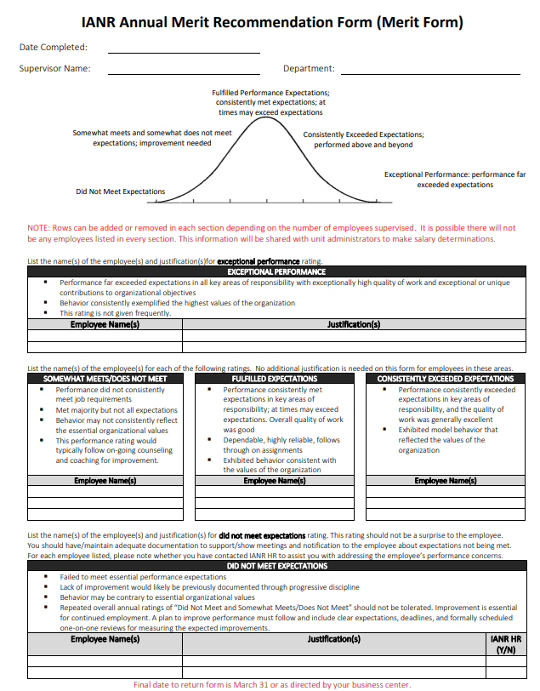
Merit Form
IANR HR will distribute the form to supervisors by March. Also available at ianrhr.unl.edu.
Created after summary and review of all performance-related information.
Documentation is critical! Merit recommendations must be supported by backup documentation.
This is a recommendation to the Unit Administrator (UA). The UA makes final merit decisions for the unit.
IANR HR can assist you with questions related to completing the Merit Form.
Notes:
The Merit Form is the tool that was developed to bridge the Performance Management process to the annual Merit Increase Process.
IANR HR will remind the business centers to initiate the process by March of each year. The forms will be sent out to supervisors by the business centers and are returned to the business centers. A copy of the form is also available on the IANR HR Website.
The Merit Form should be completed by the immediate supervisor.
The supervisor will review all performance-related information sources available to them.
The Merit Form is a “summary” document and supporting documentation does not need to be attached unless required by the Unit Administrator. However, it is critical that any merit recommendation is supported by back-up documentation. An employee should not receive an “Exceeds Expectations” or “Does Not Meet Expectations” without additional documentation to support that recommendation.
It is important to keep in mind that this is a recommendation only. The final merit decision is made by the Unit Administrator who will consider merit recommendations from all supervisors.
IANR HR can assist supervisors with questions related to completing the merit form, however, questions related to merit amounts should be directed to the Business Manager or IANR Budget Office.

Slide 9
Bell Curve
Exceptional Performance – Performance far exceeded expectations. This rating is not given frequently. Justification required.
Consistently Exceeded Expectations – Quality of work was generally excellent.
Fulfilled Expectations – Quality of work was generally good. At times may exceed expectations. Majority of employees will fall into this category.
Somewhat Met/Did Not Meet Expectations – Quality of work did not consistently meet job requirements. This rating would typically follow on-going counseling and coaching for improvement.
Did Not Meet Expectations – Failed to meet essential performance expectations. This rating should not be a surprise to the employee. Justification required.
Notes:
The philosophy of IANR performance management is to recognize and reward exceptional performance.
It would be expected for employees to “fulfill expectations” on a regular basis, however, it would be difficult for an employee to “exceed expectations” year after year. For example, special projects may not be available every year to allow an employee to perform above and beyond the majority of their peers.
The bell curve recognizes there is a normal distribution of performance within a workforce. The majority of employees meet expectations with smaller percentages of employees who either exceed or do not meet expectations.
In some companies there is a “forced” bell curve distribution. It is important to note that IANR will not apply a “forced” bell curve. Rather, it is a guide to recognize that the majority of employees are high quality performers who fulfill performance expectations.
On the Merit Form, employees will fall into one of three groups:
The majority of employees should fulfill expectations. These employees are high quality performers who meet expectations. Supervisors will simply list their names on the middle section of the form and no additional justification is required.
There may or may not be employees who did not meet expectations. If so, the supervisor would list them on the bottom part of the form and provide justification as to why they are not meeting expectations. This should not be a surprise to the employee!! IANR HR should be previously aware of any employees in this situation and will assist units to help employees get back on track.
Finally, there may or may not be employees who exceed expectations. If so, the supervisor would list them in the top section of the form and provide justification as to why they consistently perform above and beyond the majority of their peers.

Slide 10
Merit Process
Notes:
Once the Merit Form is completed, we move into the merit increase process.

Slide 11
IANR Merit Process Communication Flow
NOTE: The annual merit process is managed by the IANR Budget Office. Timing will follow merit increase guidelines provided by the IANR Budget Office each year.
SUPERVISOR
Complete
IANR Annual Merit Increase
Recommendation Form
(Merit Form)
DEPARTMENT MERIT CONTACT
(Op Mgr/Spec, HR Gen or Admin Staff)
Review Unit
Merit Forms for “big picture”
concerns
i.e., Is there a bell curve? Does known performance match ranking?
DEPARTMENT MERIT CONTACT
(Oper Mgr/Spec, HR Gen or Admin Staff)
Prepare
summary of
merit forms and “big picture” concerns
UNIT
ADMINISTRATOR
Review summary,
discusses concerns with supervisors; notify supervisors if ranking will change at unit level
Make unit decision on merit rankings
BUSINESS CENTER (Oper Mgr/Spec
or HR Gen)
Enter merit
amounts into budget system
F&P
BUDGET
Prepare merit data and supporting
documentation for Deans review
Provide IANR HR list of below expectation ratings
DEANS
Review merit data and
supporting documentation
Make IANR decision on final merit rankings
F&P
BUDGET
Enter final merit decisions into budget system
F&P
BUDGET
Inform business centers that final merit increase amounts have been entered into the budget system
BUSINESS CENTER (Oper Mgr/Spec
or HR Gen)
View final increases in budget system
Provide list of final
increases to unit
administrators and
supervisors
(Explain unit approach to allocating assigned
increase and how final amounts were determined)
Print letters
(if required by dept)
SUPERVISOR
Discuss final merit increase amount
with employee
PRIOR to July 1
Distribute letters
(if required by dept)
EMPLOYEE
Informed of merit increase amount by supervisor
Notes:
This slide documents the communication flow of the IANR annual merit process.
The timing will follow the annual merit increase guidelines provided by the IANR Budget Office each year.
The process is initiated by the business center sending the Merit Form to supervisors.
The Merit Form is then provided to the department merit contact (you can contact your business center to determine the contact for your unit). The merit forms are reviewed for any big picture concerns (i.e., all employees exceed expectations) and summarized.
The Unit Administrator (UA) will then review the summary and discusses any concerns with supervisors. They will make the final merit decision for the unit at that time.
Once the UA makes the merit decisions, the business center submits the amounts to the IANR Budget Office.
The amounts are reviewed by the Deans, finalized and then entered into the budget system.
Once the merit amounts have been determined it is important that the decision be communicated to the employee.
The IANR Budget Office will inform the business centers of the final merit amounts.
The Business Center will then notify the supervisors so they may communicate this information to their employees.

Slide 12
Things to Know about Budget Guidelines
Each year around May, budget guidelines are distributed by the IANR Budget Office to the Unit Administrators.
The budget guidelines communicate how the salary increase pool will be allocated. The amount available to employees can vary depending on how the overall percentage is allocated within each unit, so it is important to be transparent throughout the process. Your business center will inform you how increases are distributed within your unit each year. For example:
The Chancellor communicates there is a 3% salary increase pool for the year.
3% is available to your unit
The unit holds back .25% to address equity situations
You will want to be clear that 2.75% was available to be distributed to staff in your unit even though the overall salary pool was 3%
No minimum increase is required. Because there is limited funding, increases should be based upon merit/performance. Increases should not be allocated across-the-board.
Notes:
- The information on this slide is summarized from the annual budget guidelines.
It is important for supervisors to be aware of the intent of the merit process and how the process works.

Slide 13
Merit Conversations
Notes:
Once the Merit Form is completed, we move into the merit increase process.

Slide 14
Two Steps to Having a Merit Conversation
1. Explain how merit increases are determined.
Explain how the increase pool was distributed:
X.XX% was communicated by the Chancellor
X.XX% was available to your unit
.XX% was held back in your unit to address _______
X.XX% was available to be distributed to staff
Explain that increases are based upon merit/performance.
Explain that performance conversations along with other performance-related information is used by the supervisor to make a merit increase recommendation.
Explain that final merit increase decisions are made by the Unit Administrator.
Notes:
The next two slides are guides to help supervisors communicate the annual merit decision to employees.
It is important to note that we encourage supervisors to have face-to-face conversations with employees to communicate the amount of their merit increase.
This does not need to be a lengthy conversation and in some cases it could take as little as 5-10 minutes. Other supervisors may want to devote more time to this process.
We realize a face-to-face conversation might not be possible in every situation due to summer schedules and the short timeline for delivering this information, but whenever possible, this information should be communicated in person.
Step one is to explain how merit increases were determined within the unit.

Slide 15
Two Steps to Having a Merit Conversation
2. Communicate their merit increase amount and why they received that amount.
Employees should have a clear idea of their performance in relation to established expectations based on discussions during their performance conversations.
Discuss the employee’s performance. For instance, you could say “During our performance conversations we discussed how you {Exceeded, Fulfilled or Did not meet} expectations” and then provide a brief description of why.
Communicate the amount of their increase. For instance, you could say “Because you {Exceeded, Fulfilled or Did not meet} expectations this year, you will receive an increase of $_______ (or___%) increase. Your new salary will be $______ effective July 1, _____.”
Reaffirm how the employee contributes to the mission of the unit. This is also a good time for a check-in on expectations and discussion of next steps.

Slide 16
Merit Form Timeline
Merit Recommendation Forms will be distributed to the Business Centers on March 1.
Please turn in Merit Forms as soon as they are completed. Final deadline date is March 31.

Slide 17
Questions?
Performance Management and Performance Conversations:
Marci Sturek – IANR HR Coordinator
msturek2@unl.edu
402.327.1842
Annual Merit Process:
Bryan Areman - IANR Finance Director
bareman2@unl.edu
402.472.1420

